Slide 1
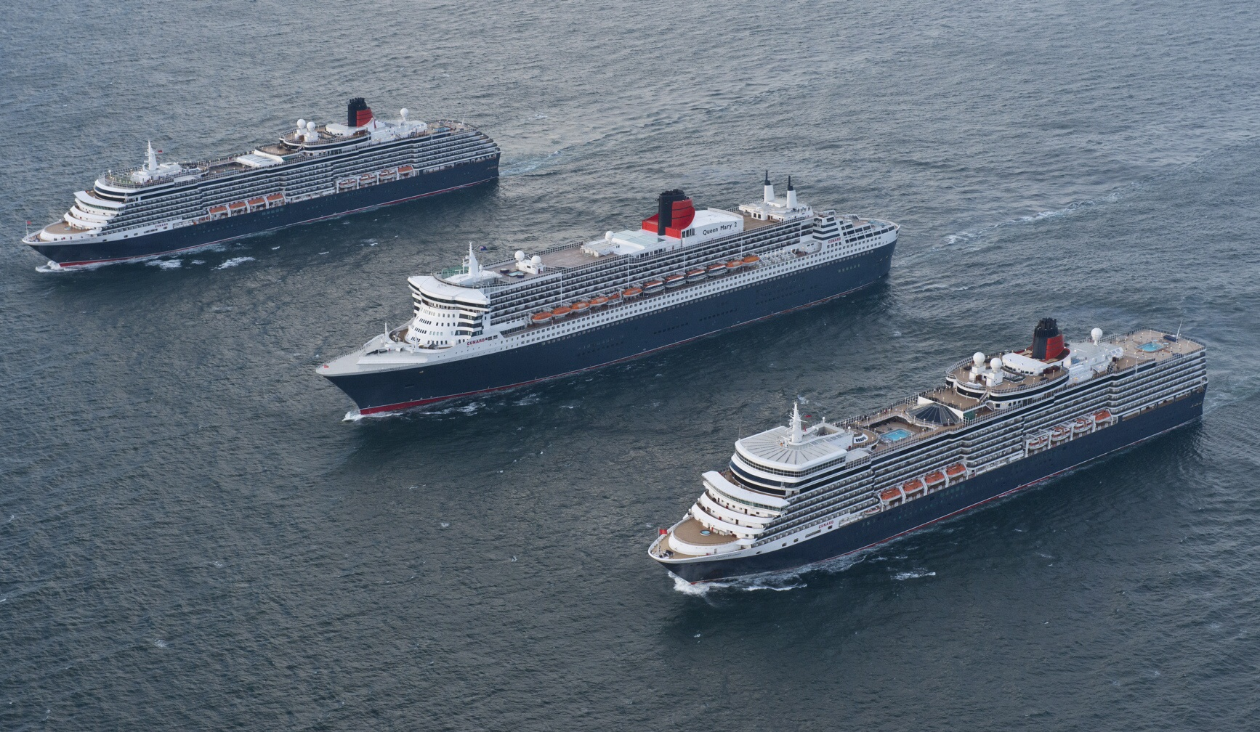
Cunard Cruise Line
By Helene Montreuil

Slide 2
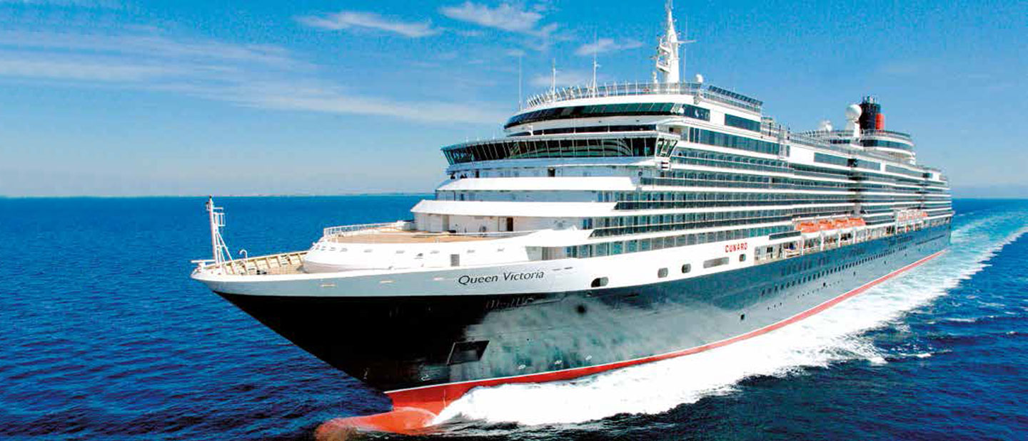
My favorite ship
M.S. Queen Victoria

Slide 3
Can you be a Cunarder?
What is a Cunarder?
Guess?

Slide 4
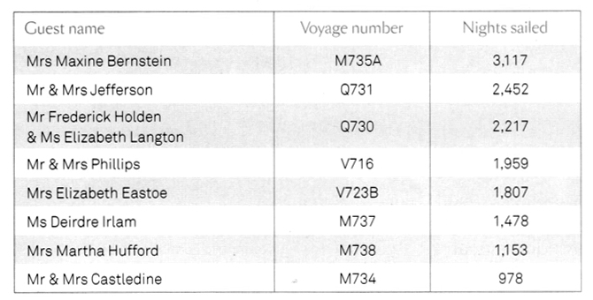
These people are true Cunarders!

Slide 5
Why these people, the Cunarders,
travel so often on board a Cunard ship?
Because, they love the life on board.
Why these people love so much
the life on board a Cunard ship?
Tradition, Elegance, Classic music.
The feeling of being a V.I.P.

Slide 6
Hummmmm! What a place for a breakfast !

Slide 7
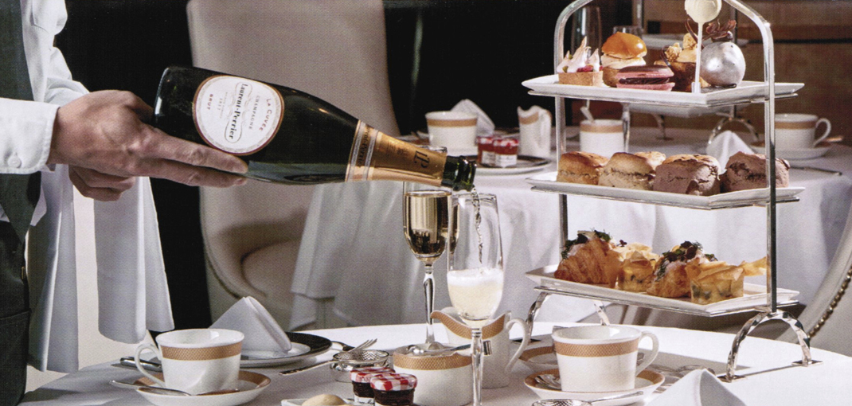
This is the Afternoon tea!
Don’t you wish to have some?
Of course, Yes, with a petit four!

Slide 8
Elegance for the Dinner Sir ! Don’t forget your jacket and your tie ! And you Lady, a nice dress and some jewels !

Slide 9
Dress code on board a Cunard’s ship I
Evenings will be split into 2 different dress codes. You will be notified of the evening’s dress code in your Daily Programme. Formal night attire consists of an evening or cocktail dress or smart trouser suit for ladies. A tuxedo, dinner jacket or dark suit with appropriate neck wear for men or you may wear formal national dress and military uniform. Informal evenings would consist of a required jacket and optional tie for gentlemen, while ladies should wear cocktail dresses, stylish separates or equivalent. No jeans or shorts.
After 6pm, shorts and blue or worn denim (for men and women) and sandals and sleeveless tops (for men) are not considered appropriate anywhere within the ship. Guests wishing to dress more casually are welcome to dine in the Kings Court or Lido buffet and relax in the Winter Garden or Garden Lounge bar, but should not use the other areas of the ship, including the Alternative Dining Restaurants.

Slide 10
This the usual dress code. Lady, dress your man and bring him with you !

Slide 11
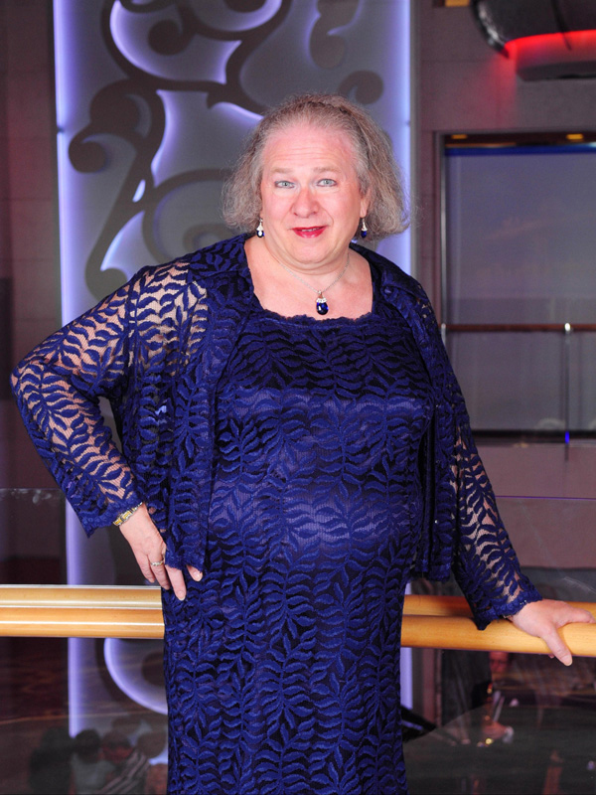
Dress code on board a Cunard’s ship II
My standard look
to go eating
My friend Jacques was expelled from the main Dining Room because he was not wearing a necktie.
He came back with one.
So, if you like to dress,
Come on and Have fun!

Slide 12
Do you like Champagne ? I am so hungry when I see that brunch !

Slide 13
To relax in sipping a cream of mint for me. Is it not a nice place to chat ?

Slide 14
Do you prefer to dance a waltz ? A cord’s quartet just for you and me ! I dream of Queen Victoria; so lovely !
https://www.youtube.com/watch?v=OYEllpwQxIc

Slide 15
And if you decide to move inside the ship, You will use one of the stairs !

Slide 16
Or perhaps, this one !

Slide 17
Or this one ! Is it not nice and perfect for Christmas ?

Slide 18
It is really Christmas time !
https://www.youtube.com/watch?v=_tKbZ2r1n0s

Slide 19
And after moving from AFT to Fore, You will enter in the theater

Slide 20
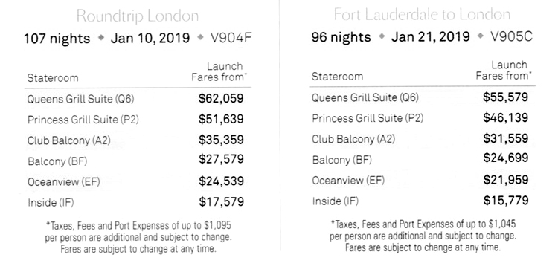
Is it so expensive?
On the 107 nights cruise, it is only $165 per day!
Less than the price of a room in any 4 or 5 stars hotel in Québec city and including three meals, beverages and daily shows, events and even, dance lessons!

Slide 21
You will visit the World in full comfort ! What can you expect or wish more ?

Slide 22
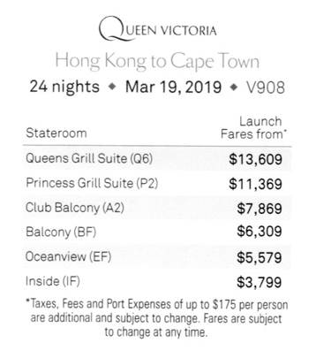
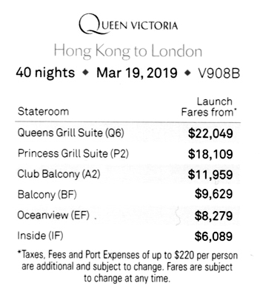
Even for a shorter time,
it is not very expensive:
$158 per day for 24 nights, or
$152 per day for 40 nights.

Slide 23
Cunard is part of Carnival Group
However, I must warn you.
Cunard is just a subsidiary of Carnival Corporation, the world’s largest travel leisure company, with a combined fleet of over 100 vessels across 10 different cruise line brands. Yes, 10 brands like:
AIDA Cruises, in Rostock, Germany
Carnival Cruise Line, in Miami, Florida
Costa Cruises, in Genoa, Italy
Cunard Line, in Southampton, United Kingdom
Fathom, in Miami, Florida
Holland America Line, in Seattle, Washington
P&O Cruises, in Southampton, United Kingdom
P&O Cruises Australia, in North Sidney, Australia
Princess Cruises, in Santa Clara, California
Seabourn Cruise Line, in Seattle, Washington

Slide 24
The fleet of Carnival Group
The biggest ones are:
Carnival Cruise Line with 26 ships
Costa with 15 ships
Holland America with 15 ships
Princess with 17 ships.
So, with only 3 ships, Cunard looks very small, but Cunard has been one of Carnival’s most high-profile brands.

Slide 25
Note about the statement on the next page
Carnival corporation shows financial statements only for the group, meaning the ten cruise lines

Slide 26
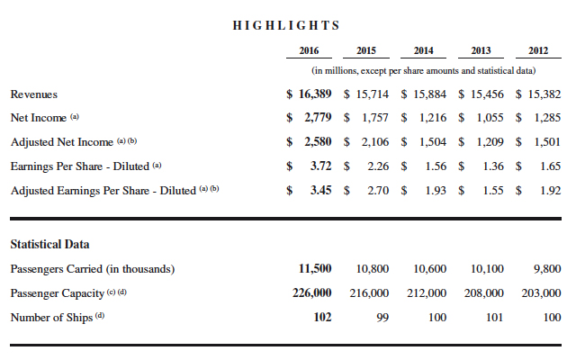
Gross income: $ 16,389,000,000 - WOW!
Number of passengers: 11,500,000
Net income: $ 2,779,000,000

Slide 27
The cruise industry
Direct spending by the cruise industry in Europe grew by 3% to 14.5bn in 2010. There has been 73% growth between 2005 and 2010. The UK itself followed a 6% rise to 2.4bn in 2009 with an even larger 7% growth in 2010 when total direct spending reached 2.6bn. The number of UK jobs generated by the industry rose to nearly 59,000, a 50% increase in just four years.
Despite the global economic crisis which took hold in the second half of 2008 and continued through 2009 and 2010, the signs are that cruising has proved more resilient than other tourism and leisure sectors and that its growth will continue unabated. Look at the following statistics about the big ships! The cruise industry has never been so prosperous. More and more ship and not only ship, but huge ships being able to carry more than 6,000 passengers!

Slide 28
Which is the world’s biggest cruise ship? I
In 2000, Royal Caribbean launches a new challenge to the world cruise in building the first 3,000 passenger’s ship with the Explorer of the Seas, a 5,400 passenger’s ship in 2010 with the Allure of the Seas, and a 6,700 passenger’s ship in 2018 with the Symphony of the Seas.
Norwegian Cruise Line has adopted the same strategy: NCL built in 2001 its first 2,300 passenger’s ship with the Norwegian Star and a 4,000 passenger’s ship in 2010 with the Norwegian Epic.

Slide 29
Which is the world’s biggest cruise ship? II
By passenger capacity
Symphony of the Seas, due in 2018: 6,870
Four unnamed MSC "World Class" cruise ships: 6,850
Harmony of the Seas*: 6,780
An unnamed Royal Caribbean Oasis class ship, due in 2021: 6,360
Allure of the Seas and Oasis of the Seas: 6,296
A total of 17 ships with room for at least 5,000 passengers are currently under construction.

Slide 30
Which is the world’s biggest cruise ship? III
By length
Harmony of the Seas: 1,188 feet
Oasis of The Seas and Allure of the Seas: 1,187 feet
Ovation of the Seas: 1,142 feet
Two Quantum class Royal Caribbean ships, due in 2019 and 2020: 1,141 feet
Quantum of the Seas and Anthem of the Seas: 1,139 feet
Two unnamed Star Cruises ships, due in 2020 and 2021: 1,135 feet
Queen Mary 2: 1,132 feet

Slide 31
Which is the world’s biggest cruise ship? IV
By gross tonnage
Symphony of the Seas, due to launch in 2018, and another unnamed Oasis class ship, due in 2021: 230,000 GT (estimate)
Harmony of the Seas*: 226,963 GT
Oasis of The Seas and Allure of the Seas: 225,282 GT
Two unnamed Star Cruises ships, due in 2020 and 2021: 204,000 GT (estimate)
Four unnamed MSC "World Class" cruise ships: 200,000 GT (estimate)

Slide 32
Can Cunard be a competitor with the others ?
Yes, Cunard can
How ?
In choosing her market
Which one ?
People looking for something special
What can be special?
Elegance
British style
Classical music
Special thematic cruises

Slide 33
What is the Cunard market ? People who are looking for something special

Slide 34
Yes ! Special cruises for special people !
https://www.youtube.com/watch?v=aT2TDWGcv-Y

Slide 35
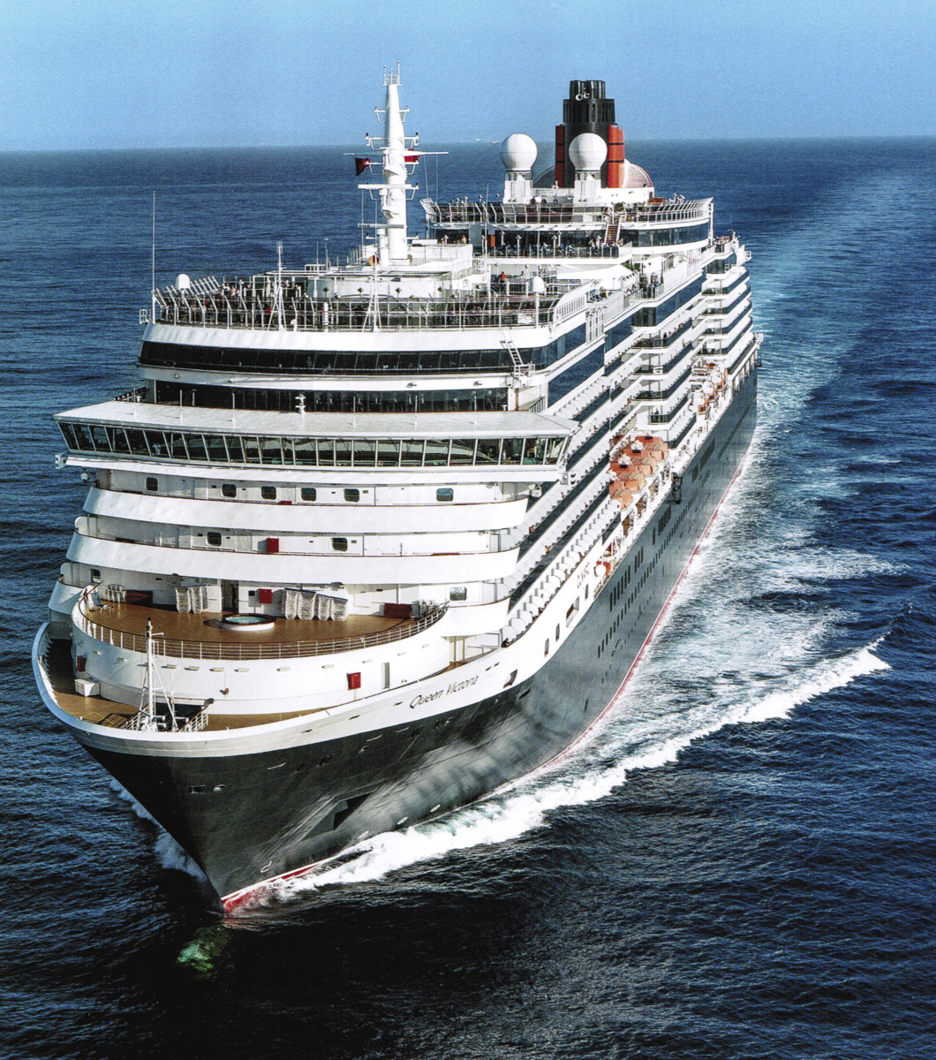
Come on board!
I am waiting
for you !
Anchors Aweigh
And see
the World !
Bye !

